Slide 1
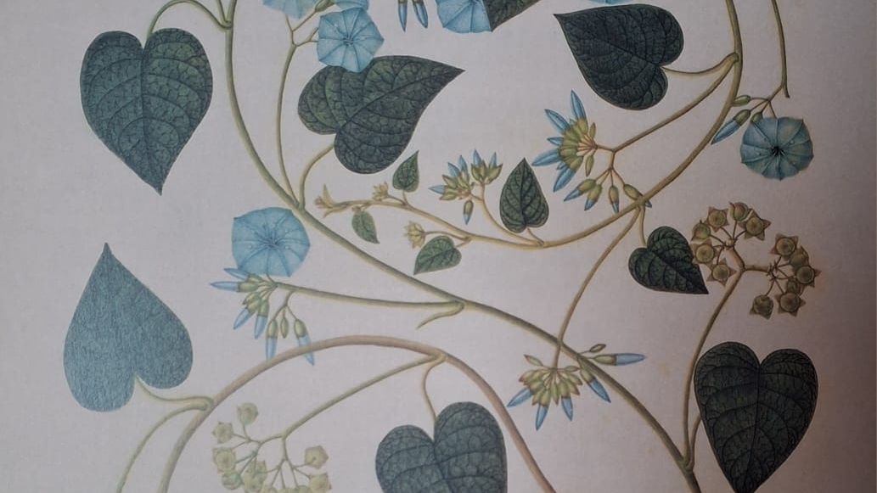
Know the Weeds
Washing detergent for dark clothes:
1 liter of water
50 crushed leaves
Cook 15 minutes
Leave for an hour
Ethnobotany, traditional folk medicine
and the need to return to ancient knowledge
in the context of the climate crisis and apocalyptic prospects
Aleksandra Lukaszewicz
aleksandra.alacaraz@gmail.com
Notes:
Bluszcz: IVY
Washing detergent for dark clothes:
1 liter of water
50 crushed leaves
Cook 15 minutes
Leave for an hour

Slide 2
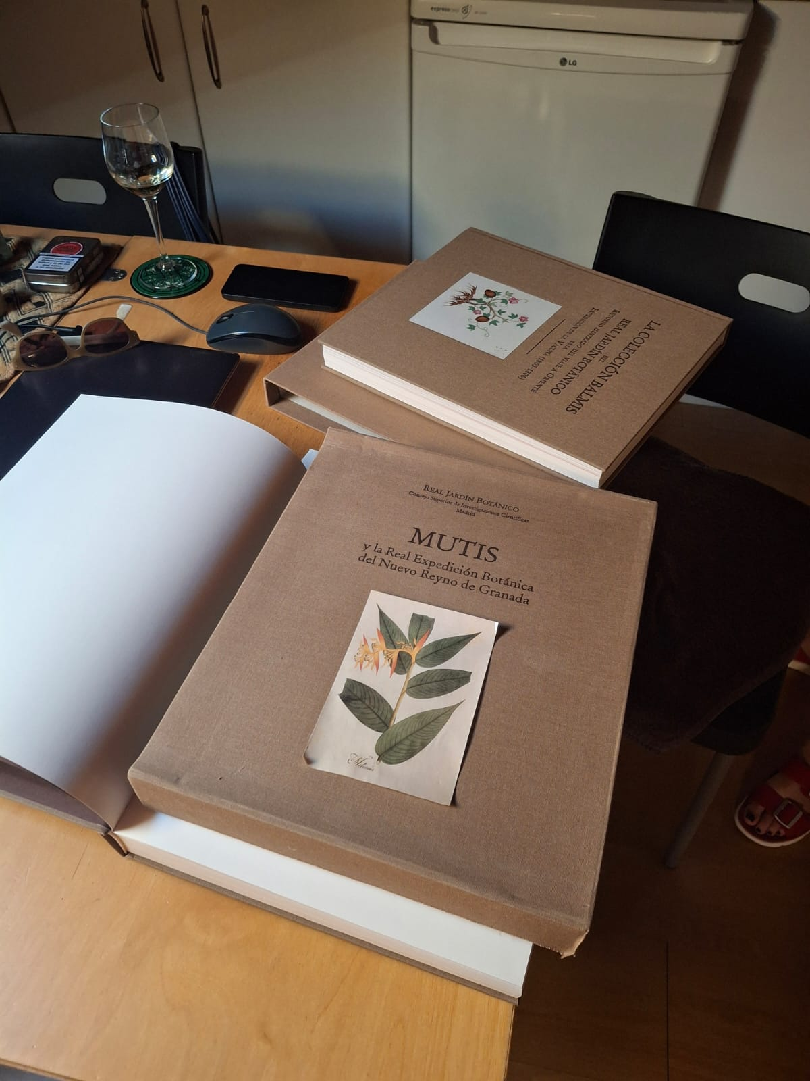
Ethnobotany and traditional folk medicine
Ethnobotany – the science of plants and their culturally defined uses developed since the travels of colonizers during the development of science (I. Newton, Carlolus Linnaeus) - 18th / 19th century.
Traditional folk knowledge of plants had a different history in the Americas and another in Europe.

Slide 3
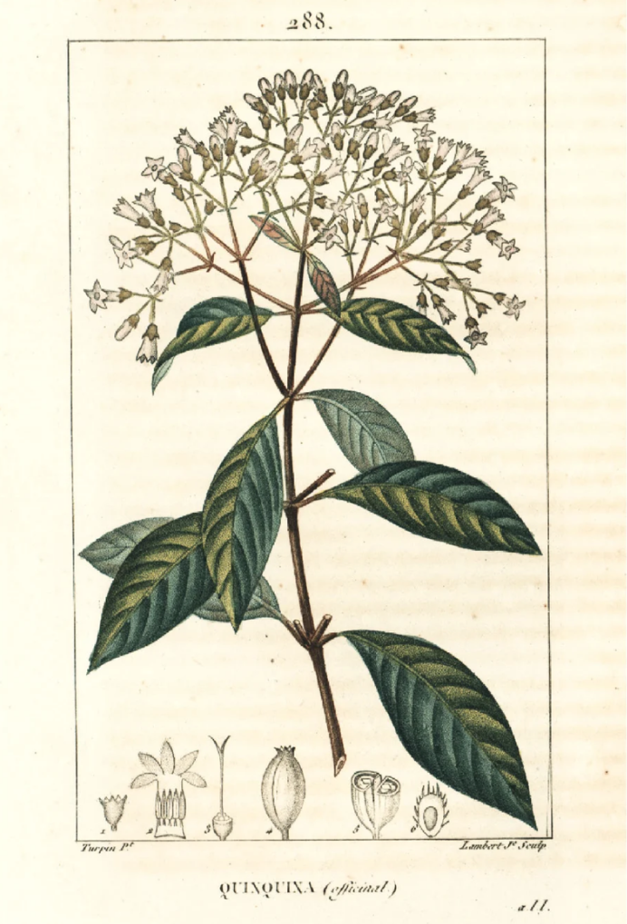
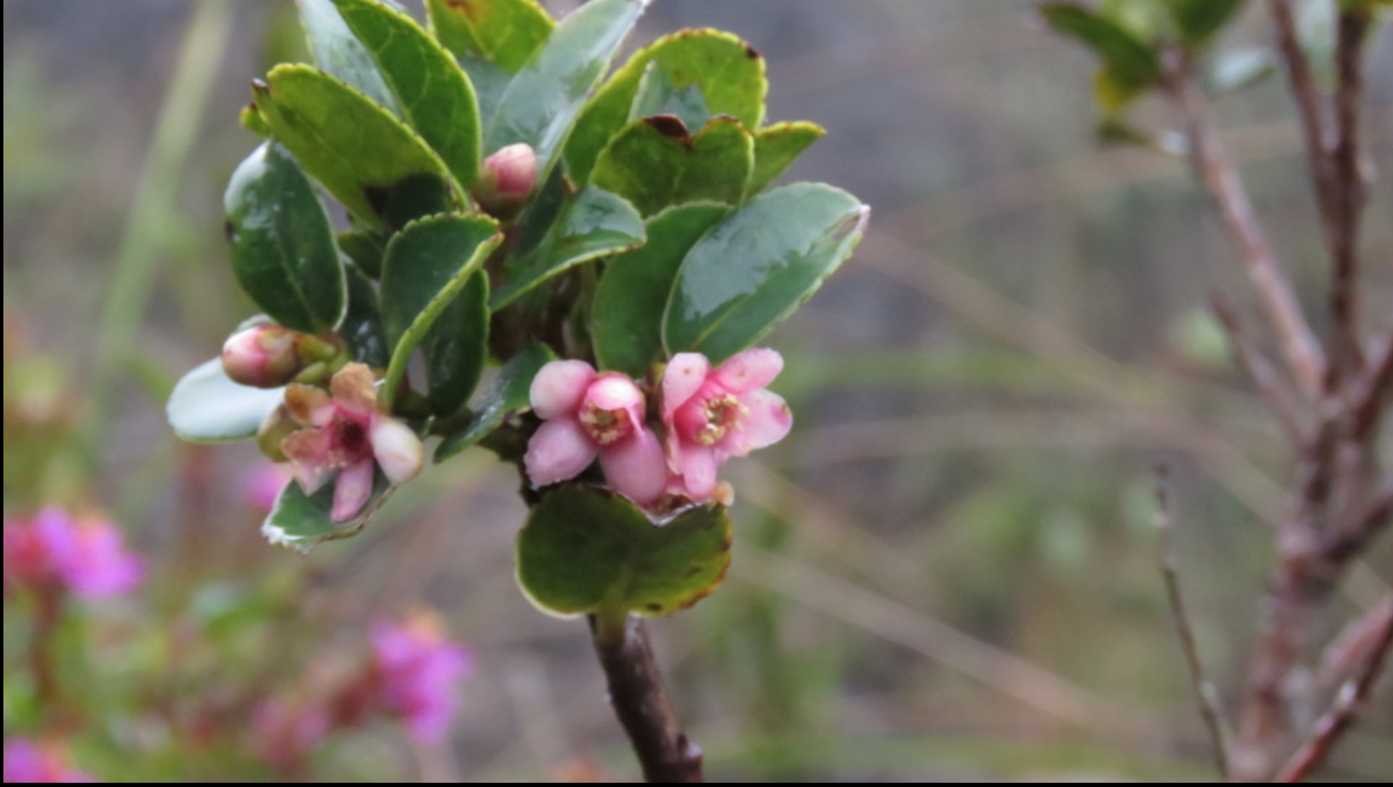
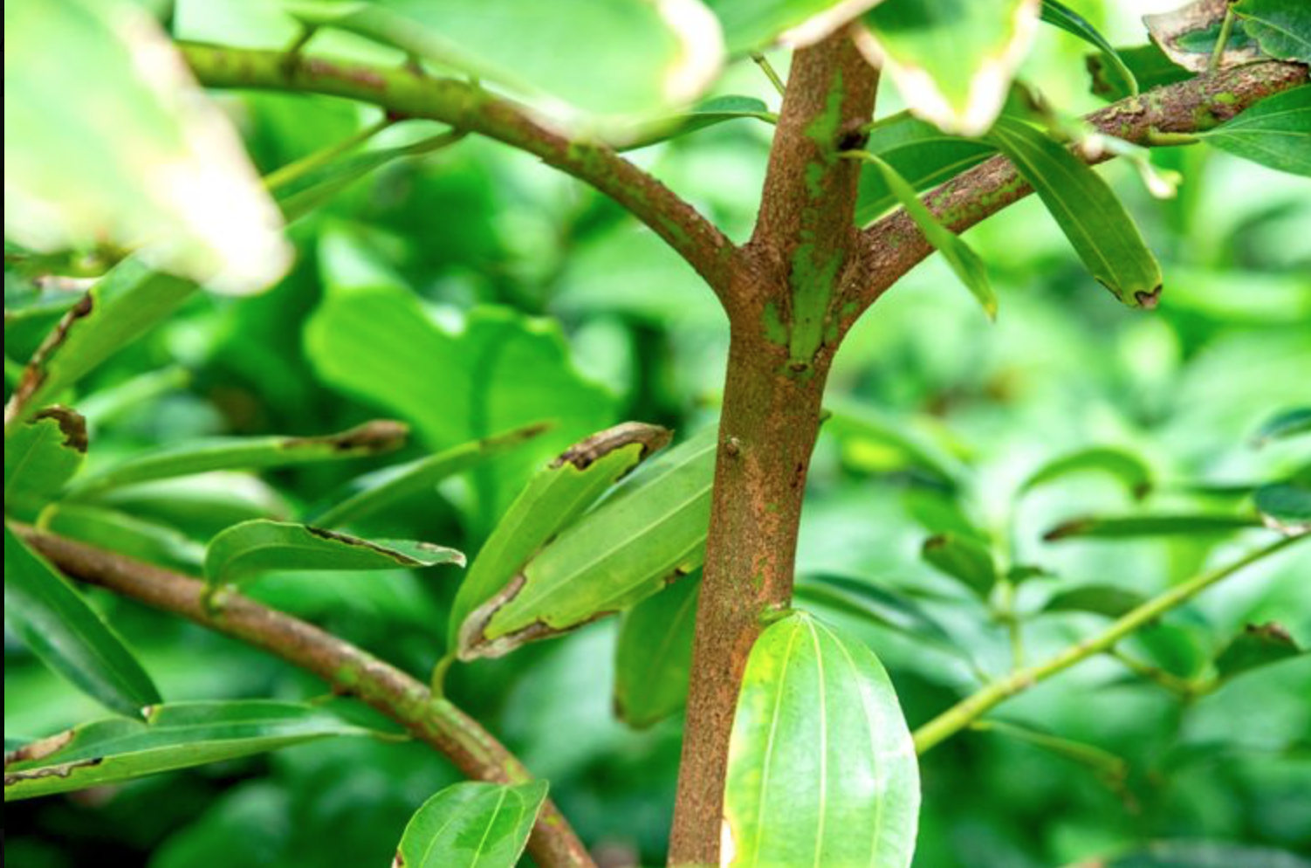
Scientific expeditions in colonized countries
Focus on exploiting useful raw materials found and described during research – e.g.:
Cinnamon
Bogota Tea – discovered by Jose Celestina Mutis – Nuevo Reino de Granada, today Colombia: the Real Expedicion Botanica – 2nd part of the 18th century)
Cinchona -– the tree from which quinine is made discovered for Europeans by Jesuits in the 17th century

Slide 4
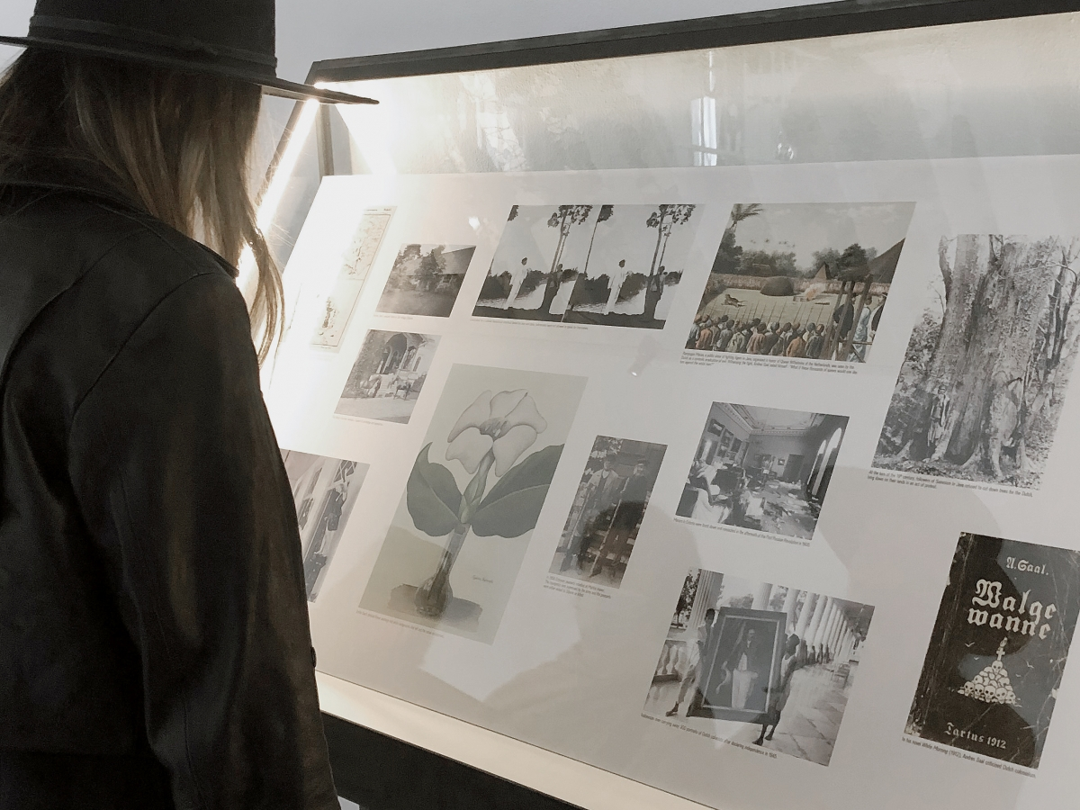
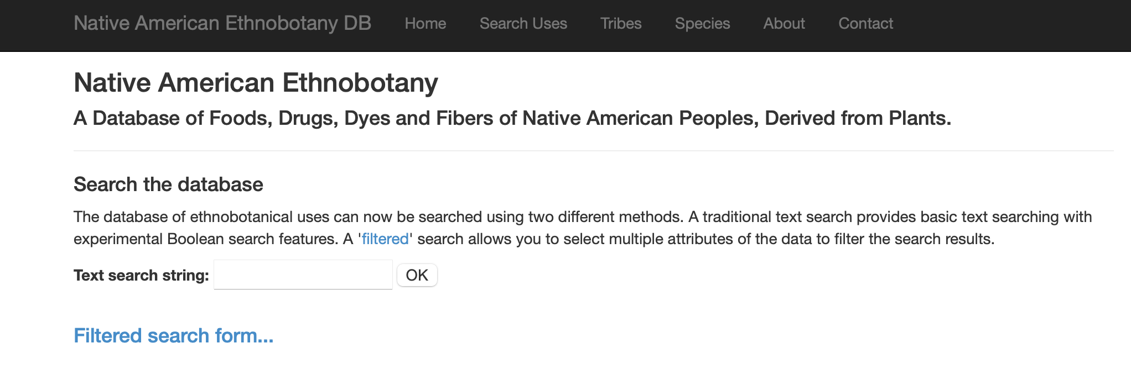
A critique of the colonial approach and its legacy
Criticism of such an imperialist approach that exploits natural resources, including plants and people present for ex. on Venice Biennale exhibitions.
Estonian pavillon: Orchidelirium. An Appetite for Abundance – by Kristina Norman and Bita Razavi referring to Emilie Rosalie Sall – producer and consumer of the orchidelirium of the 19th-century Europe and the United States while living in Java in Indonesia – then a Dutch colony.Venice Biennale - Giardini, 2022
Nevertheless, the original attention to the flora of the New World for exploitative purposes and the subsequent criticism of the colonial approach has meant that knowledge of the use of plants in medicine, for food and dyeing has often been preserved, such as „Native American Ethnobotany. A Database of Foods, Drugs, Dyes and Fibers of Native American Peoples, Derived from Plants” (http://naeb.brit.org )
Notes:
Estonian pavillon. Orchidelirium. Venice Biennale 2022
An Appetite for Abundance by Kristina Norman and Bita Razavi.
Curator: Corina L. Apostol. Venice Biennale, 2022. Photo: Echo Gone Wrong
Emilie Rosalie Saal was a producer and consumer of the orchidelirium of 19th-century Europe and the United States: while living with her husband, the famous Estonian writer, photographer and topographer Andres Saal in Java in Indonesia, which was then a Dutch (!) colony between 1899 and 1920, she made detailed drawings of rare orchids

Slide 5
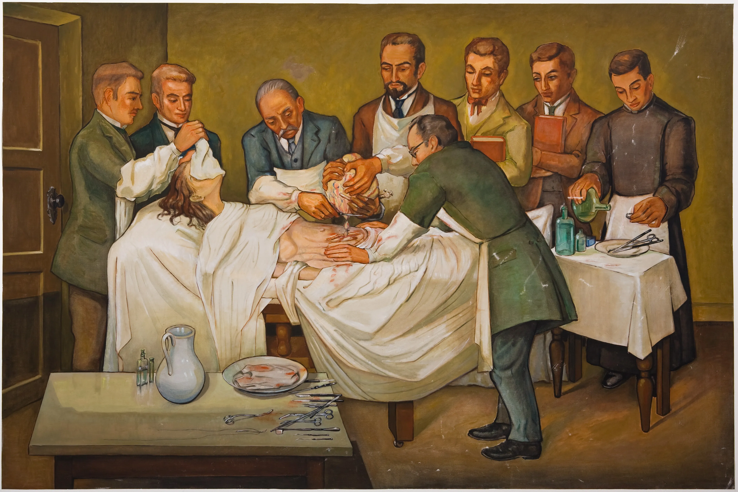

Traditional knowledge of plant uses in Europe
The dismissal of those familiar with herbalism as witches – especially during the Reformation and the development of medical studies at universities, led to the professionalization of medical treatment, from which women were excluded for several centuries.
European approach was dominated by rational science with ambitions of objectivity.
Today in Poland there is a resurgence of interest in this area, as evidenced by numerous workshops, festivals, and also the scientific magazine „Etnobotanika, etnomedycyna i etnografia w Polsce”.
Eduardo Ramirez,
Colombian Surgery: Ovariectomy, 1954.

Slide 6
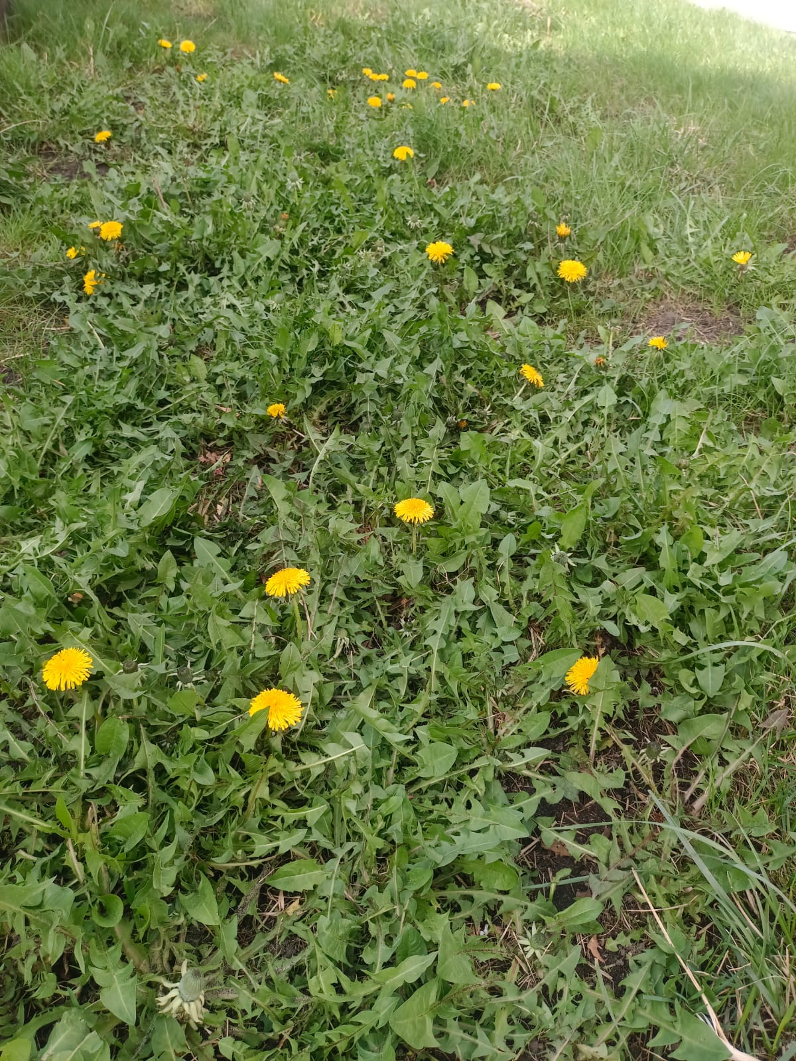
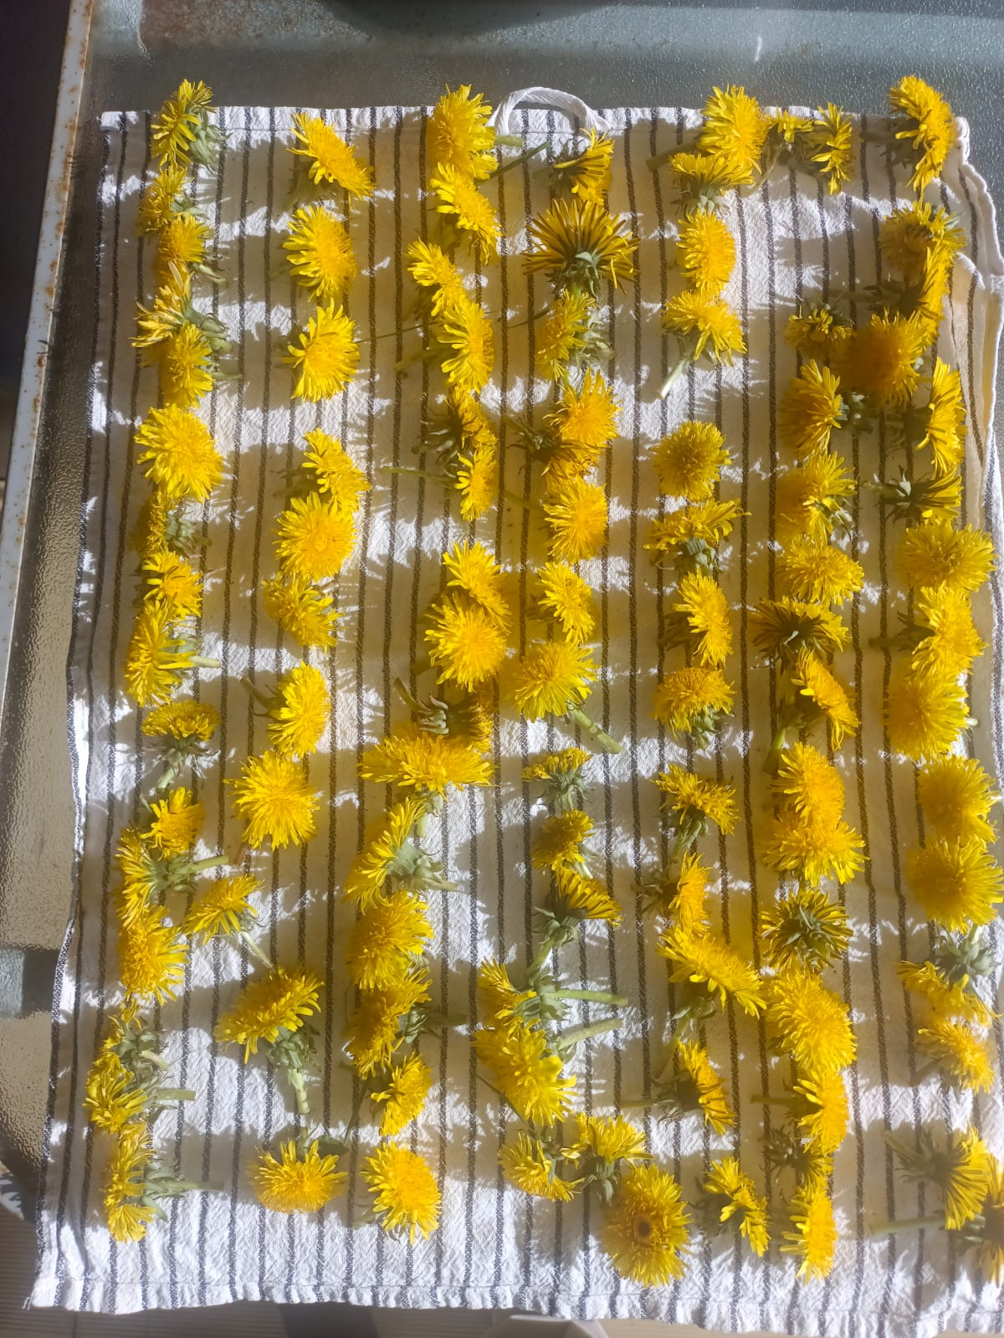
My wild meadow
Dialogue between the person or family living in the house and what naturally grows in the garden – Dialogue between the body and the environment.

Slide 7
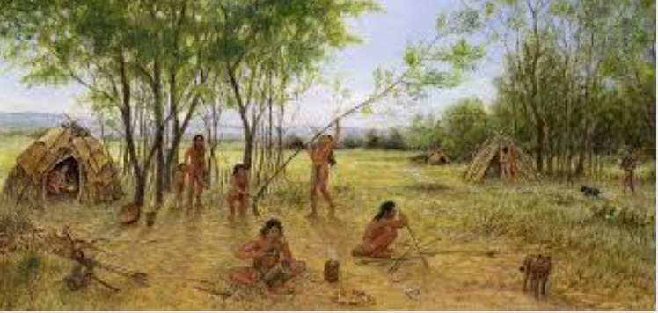
Paleolithic hunter-gatherer communities vs. modern gatherer communities going to „climate hell”
Homonids' equilibrium with the environment when they numbered about 1 million individuals for most of our erected history (from 2.5 mln BC till 100.000 years BC (the Lower Paleolithic Era).
Later important moment – the start of the Neolithic Era: beginnings of farming and cultivating that started around 10.000 years BC brought exponentially growing cumulation of goods and wealth and the exploitation of the world’s resources.

Slide 8
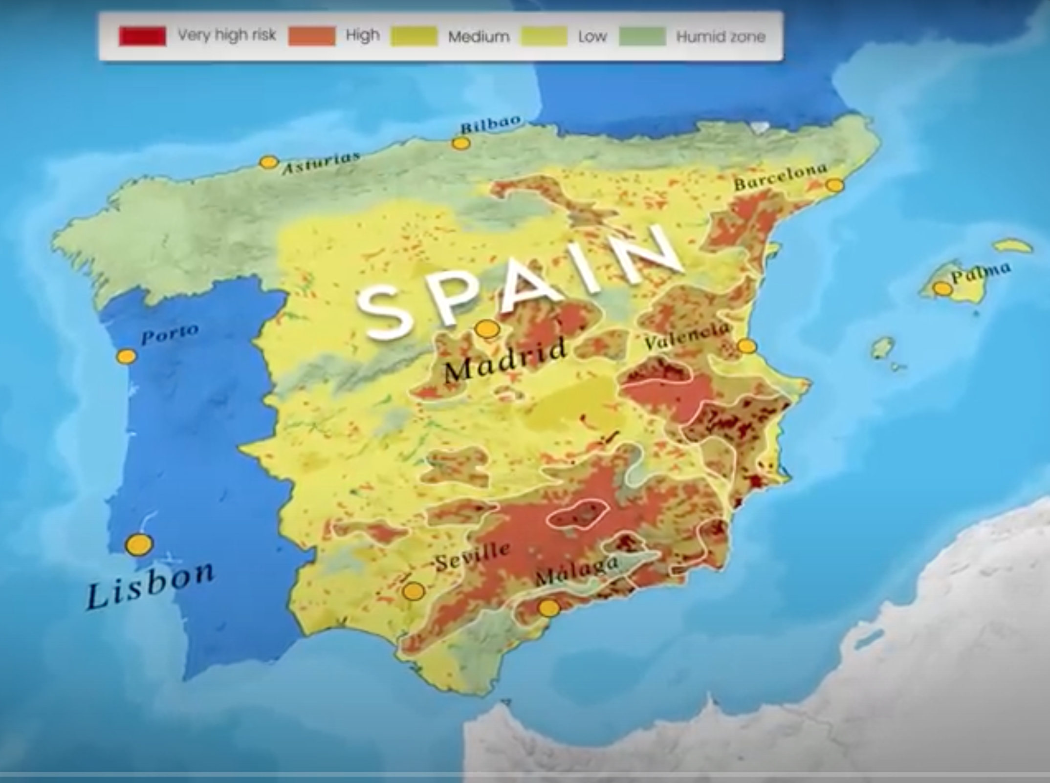
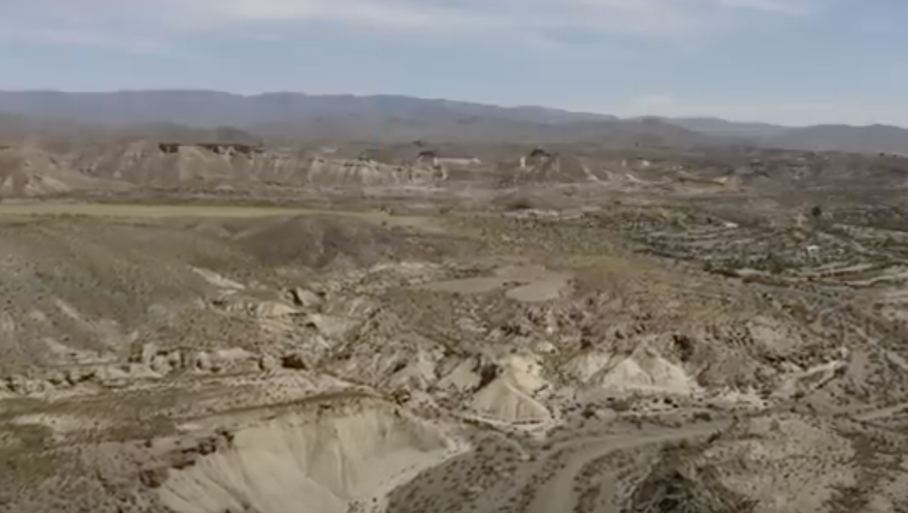
Jaime de Val's perspective – climate crisis, sixth species extinction
The current situation –is heading for an imminent apocalypse and “climate hell” – motivates him to call for changes in their living practices, including, above all, food, in order to adapt to the environment (not to prevent catastrophe, it's too late for that).
We must learn back what we have forgotten – to return to the body through the sense of proprioception, but also to learn how..... (from the project).
According to UN 18% of Spain may soon become irreversibly deserted.
Tabernas, Spain
Notes:
Tabernas, Spain
18% may become irreversibly deserted.

Slide 9
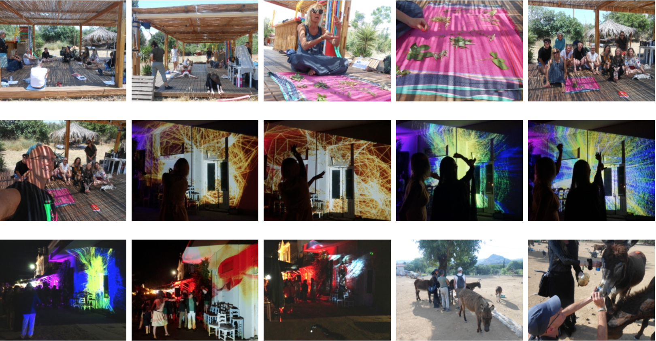
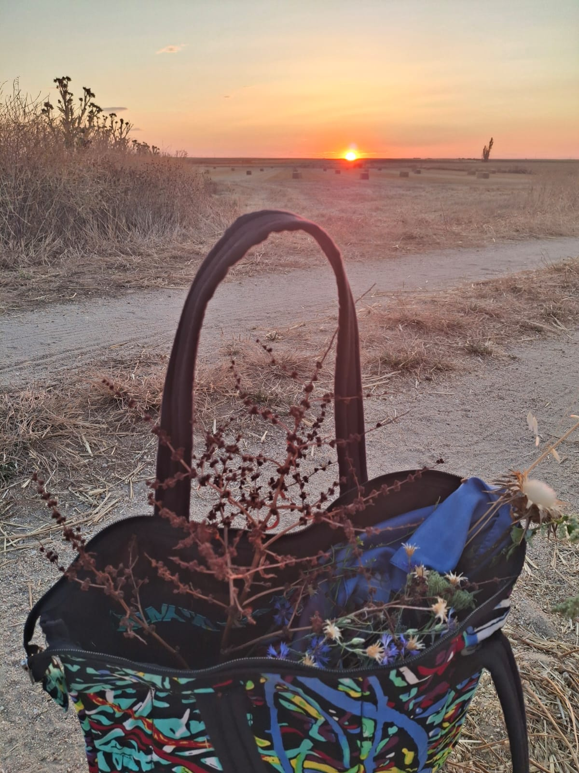
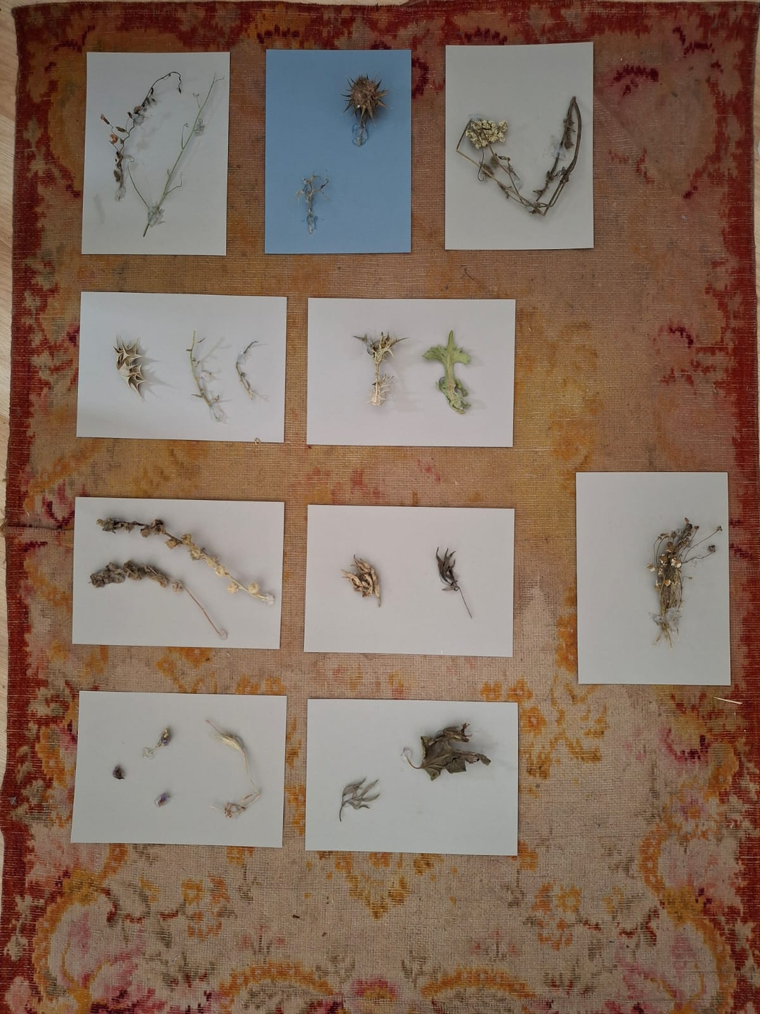
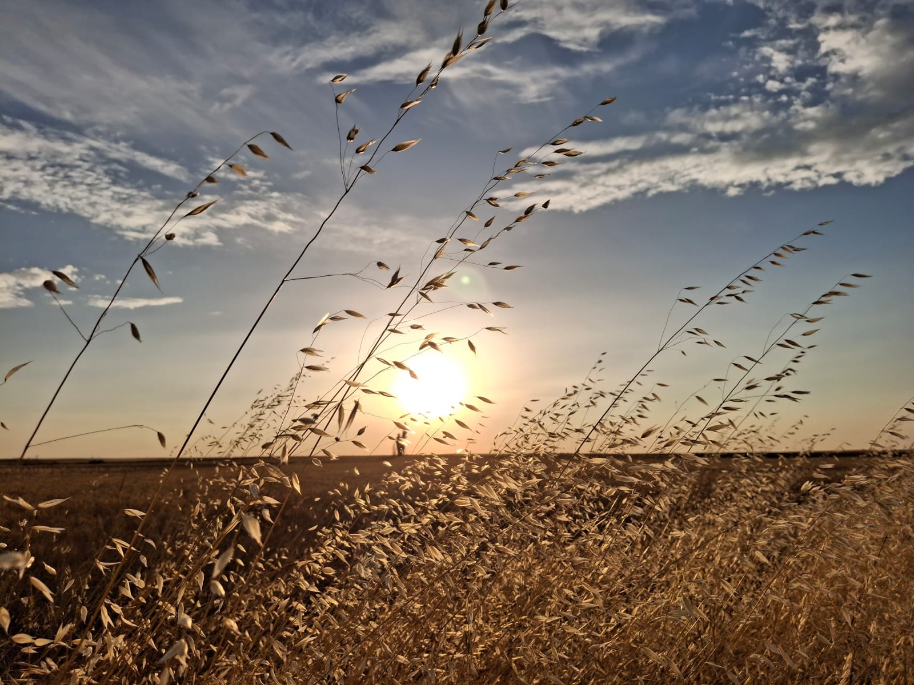
3rd Metahuman Futures Forum
Metahuman Lab at the Queer Festival in Skala Eressos. 28th -30th of May 2024
https://metabody.eu
Bodynet – Khorós. Choral Arts and Embodied Media for Social Plurality and Planetary Health
LAB 13: July-August, Zorita de la Frontera, Salamanca, Spain

Slide 10
Hiszpania

Slide 11
Polska

Slide 12
Kenia

Slide 13
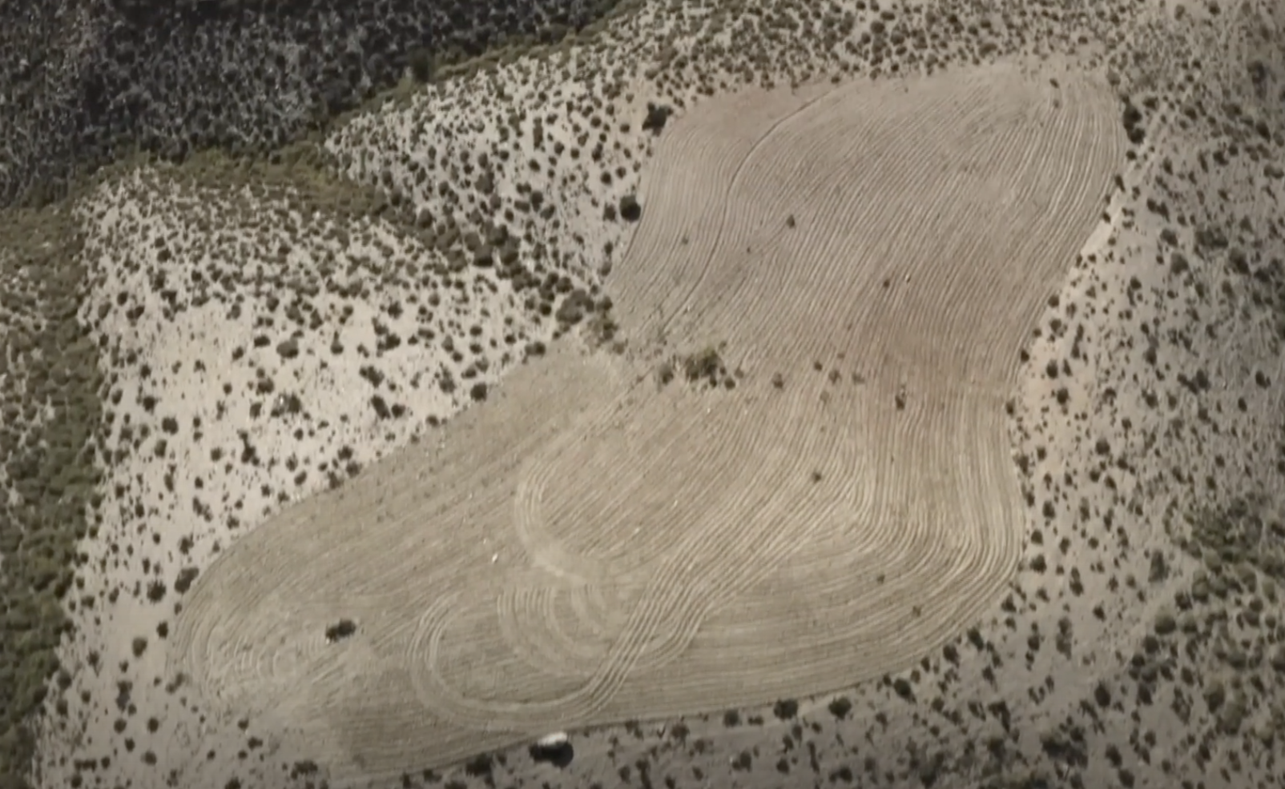

Thank you for your attention and invite you to take a walk together
Aplikacja PlantNet:….
https://identify.plantnet.org

